Slide 1
Introduction to Python Tkinter
Session 16

Slide 2
Objectives
Introduction to Tkinter
Widgets in Tkinter
Label & Button widget
RadioButton & CheckBox widget
Combobox & Message widget
Entry & Text widget

Slide 3
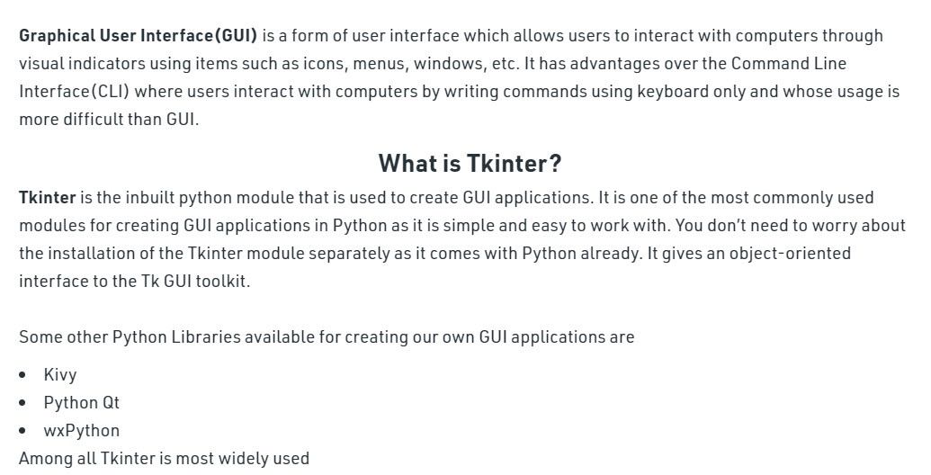
Introduction to Tkinter

Slide 4
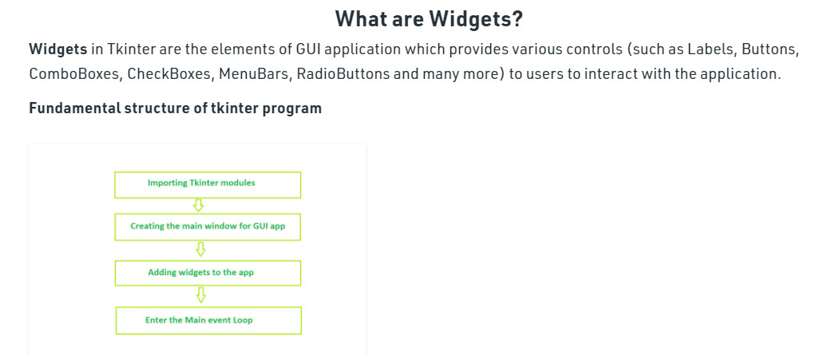
Introduction to Tkinter

Slide 5
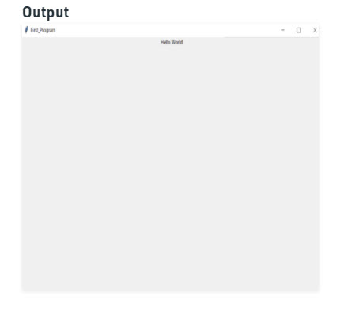
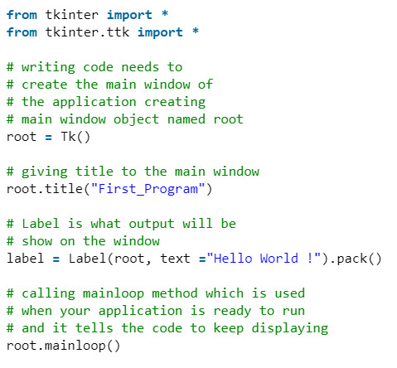
Introduction to Tkinter

Slide 6
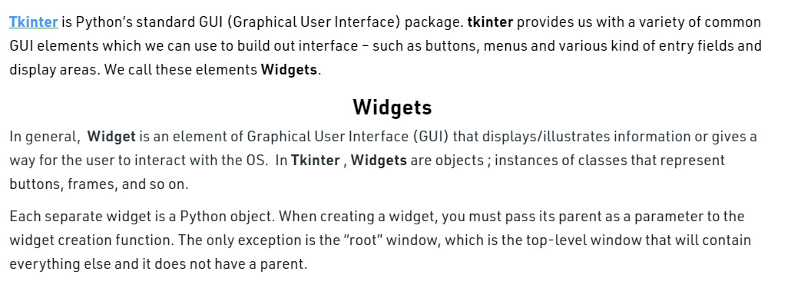
What are Widgets in Tkinter?

Slide 7
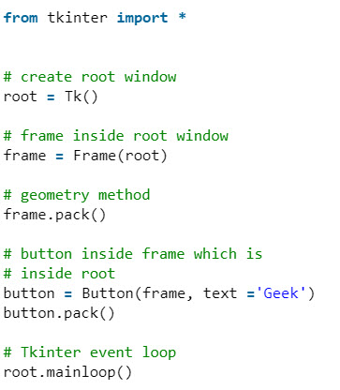
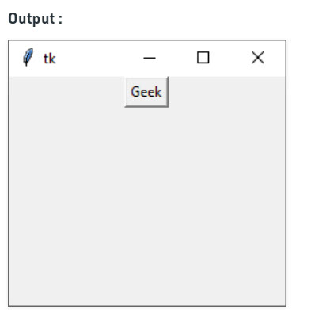
What are Widgets in Tkinter?

Slide 8
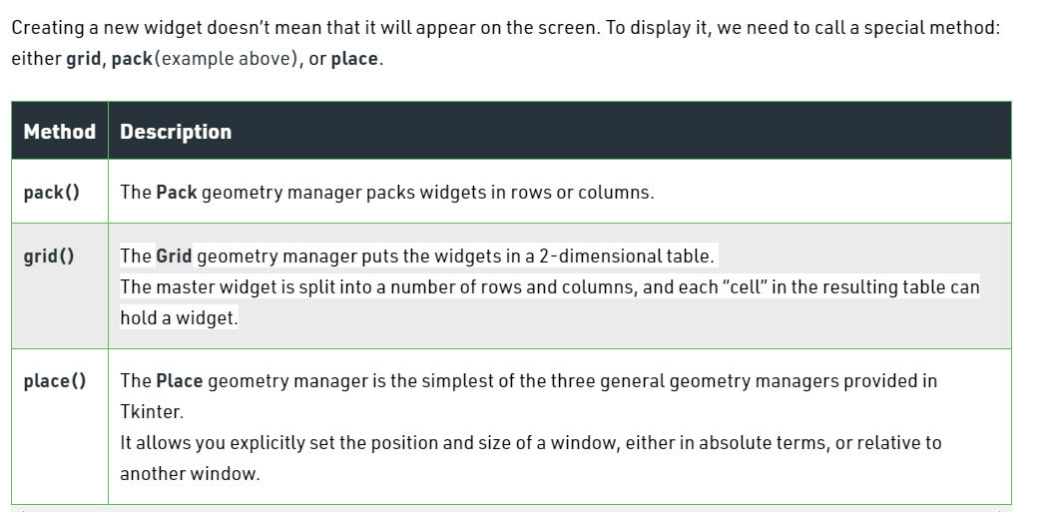
Geometry Management

Slide 9
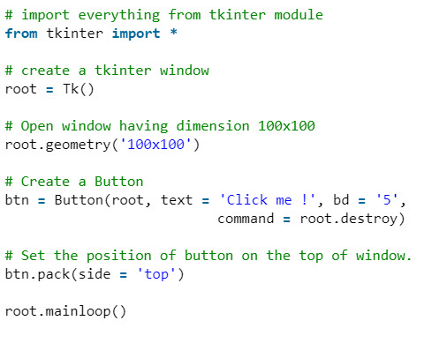
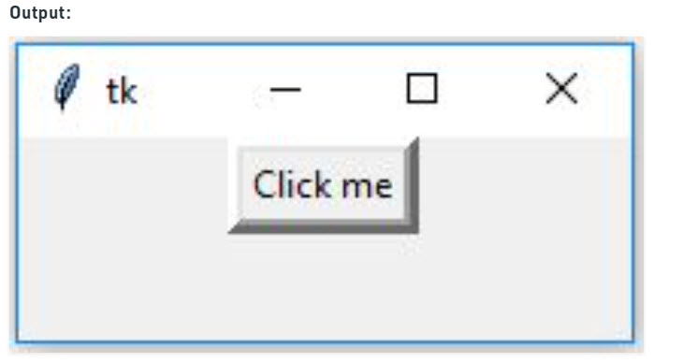
Creating a button in tkinter

Slide 10
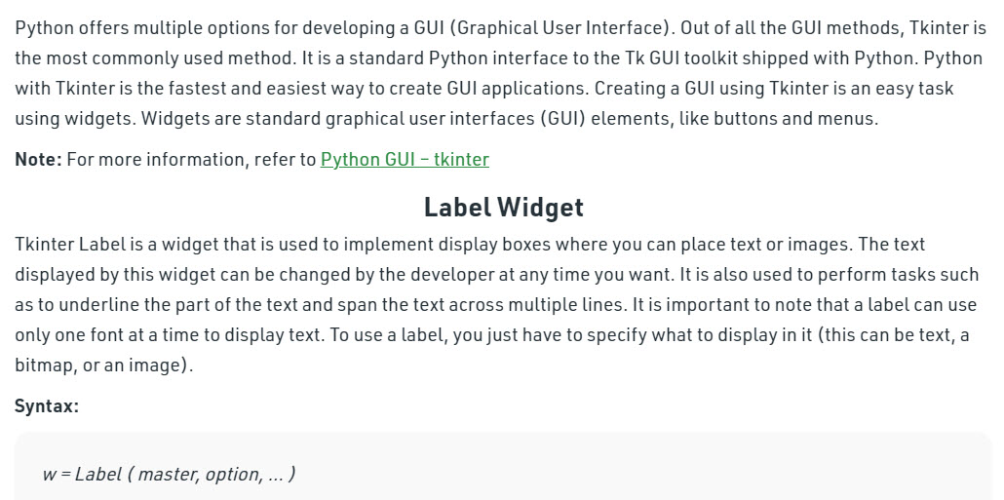
Python Tkinter – Label

Slide 11
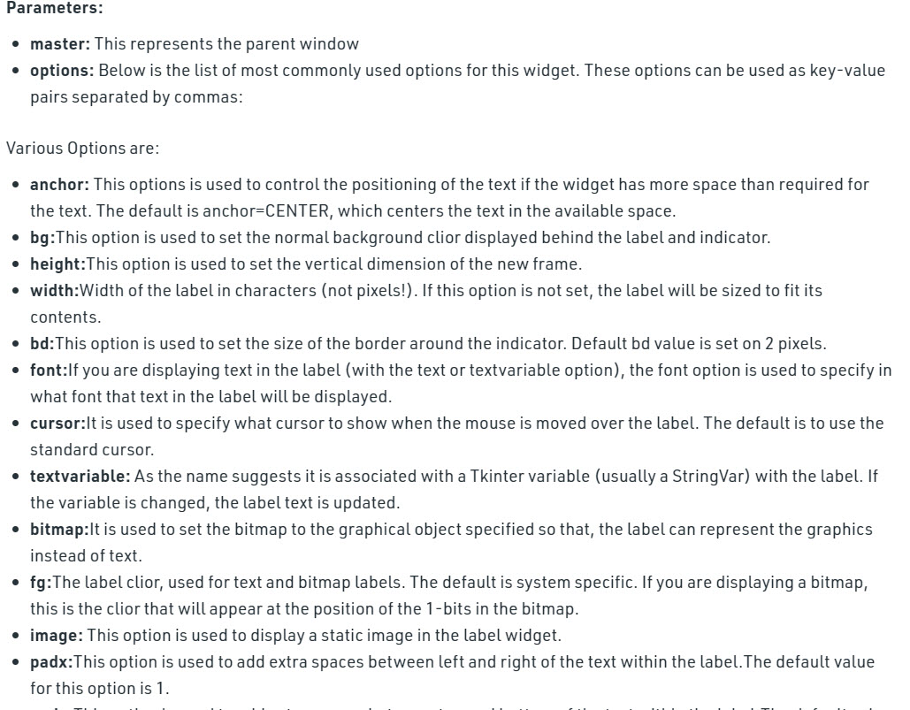
Python Tkinter – Label

Slide 12
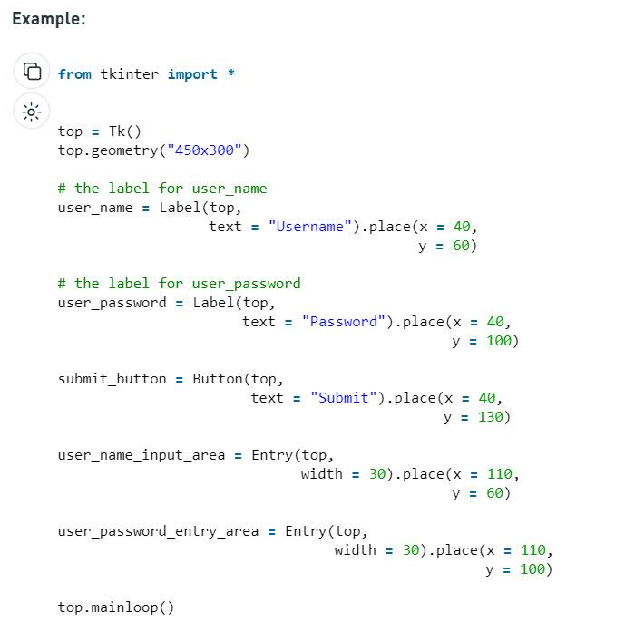
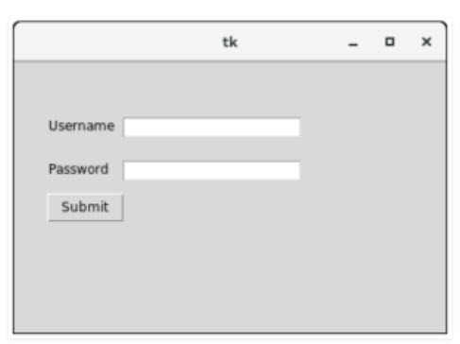
Python Tkinter – Label

Slide 13
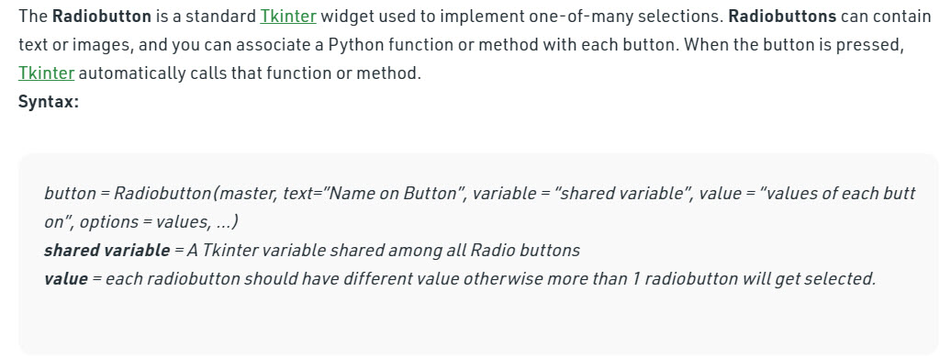
RadioButton in Tkinter

Slide 14
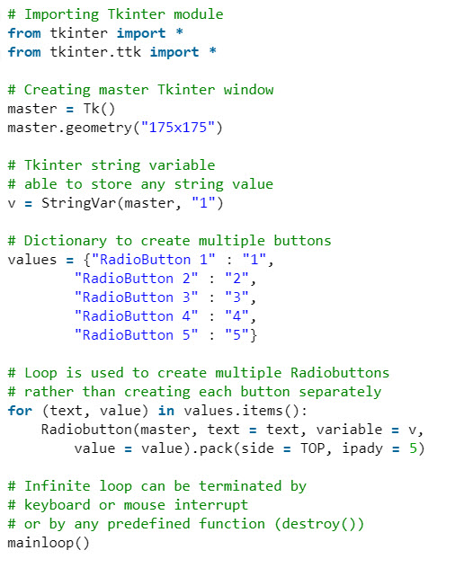
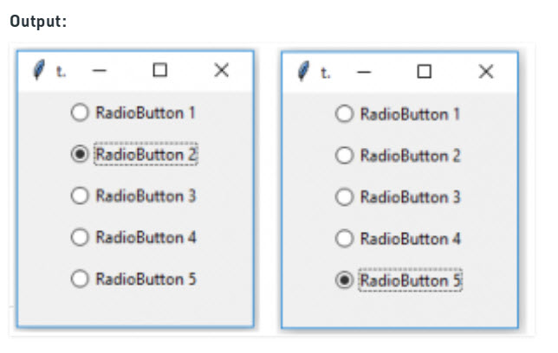
RadioButton in Tkinter

Slide 15

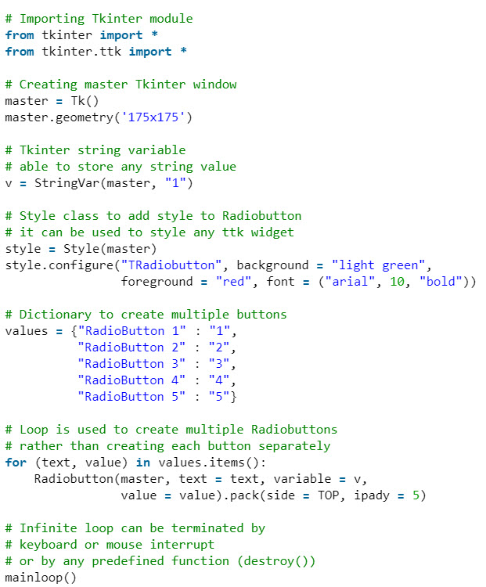
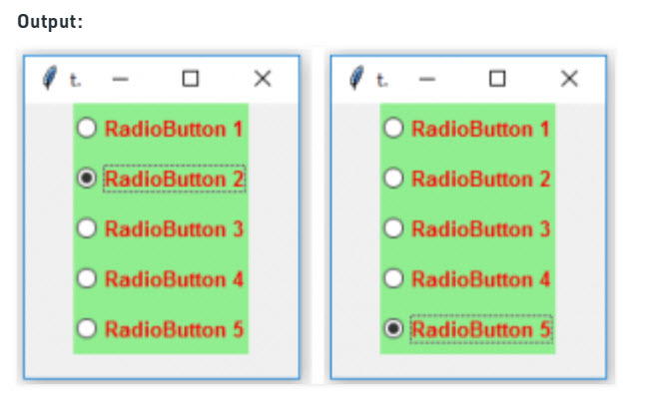
RadioButton in Tkinter

Slide 16
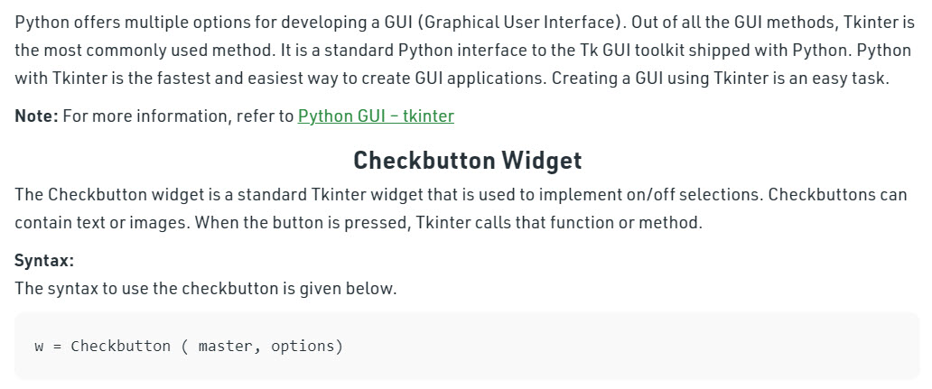
Python Tkinter – Checkbutton Widget

Slide 17
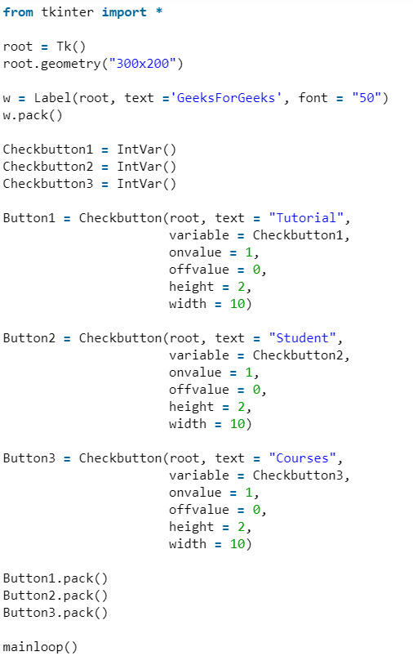
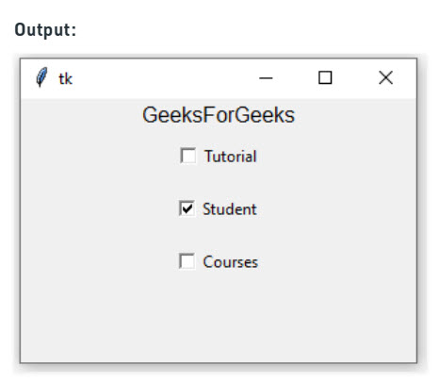
Python Tkinter – Checkbutton Widget

Slide 18
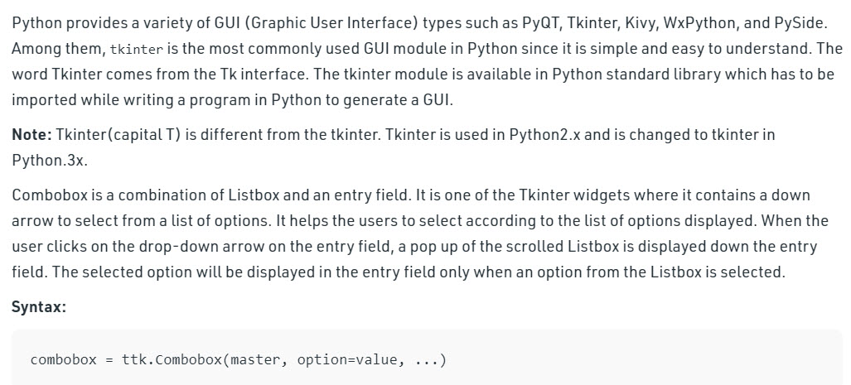
Combobox Widget in tkinter | Python

Slide 19
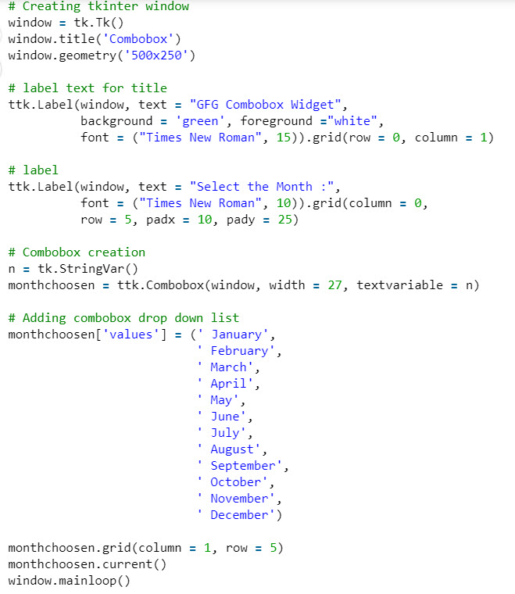
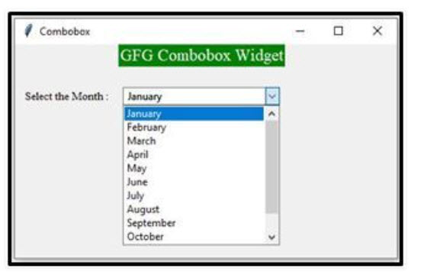
Combobox Widget in tkinter | Python

Slide 20
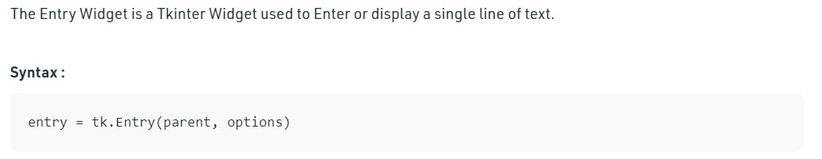
The Entry Widget

Slide 21
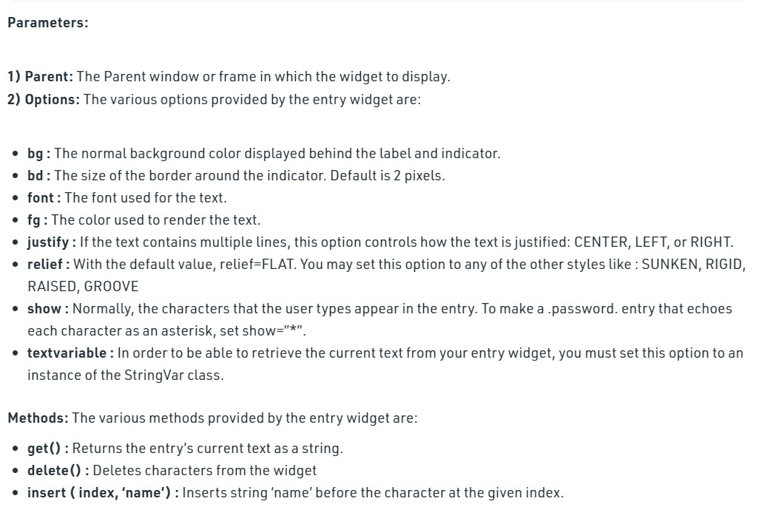
The Entry Widget

Slide 22
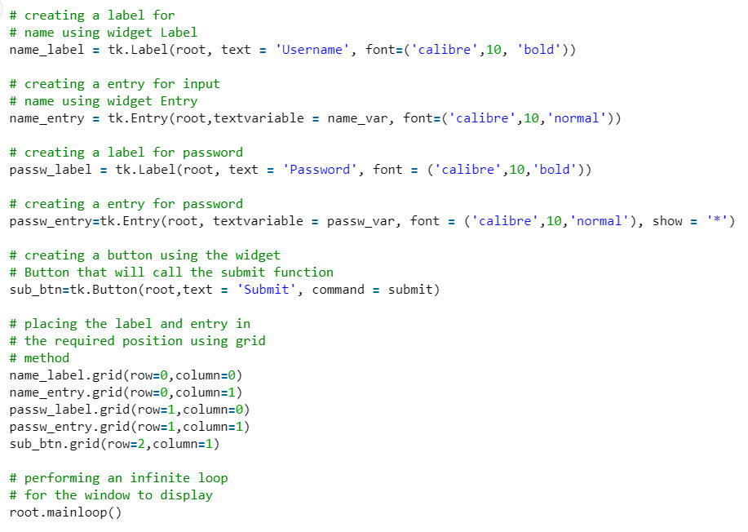
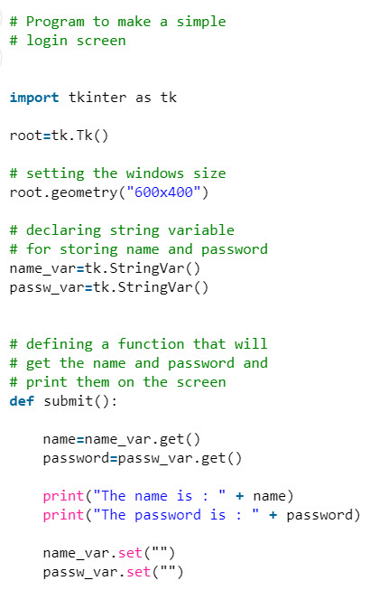
The Entry Widget

Slide 23
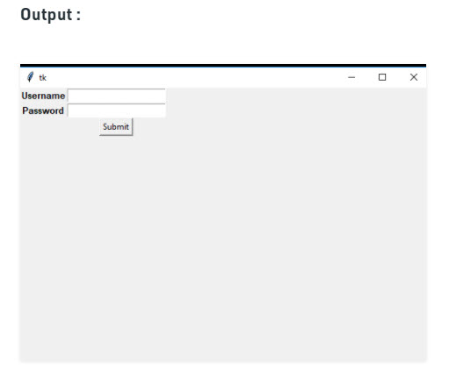
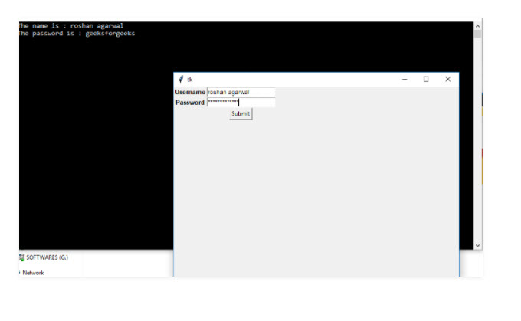
The Entry Widget

Slide 24
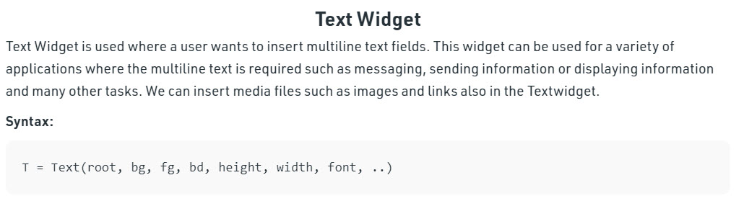
Python Tkinter – Text Widget

Slide 25
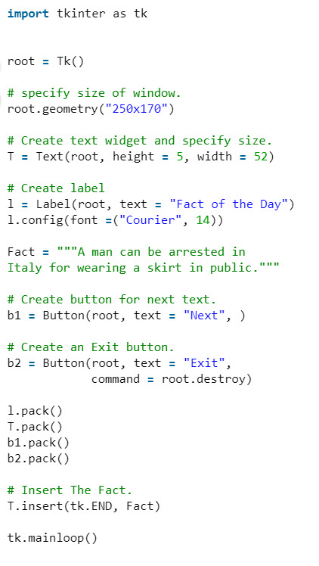
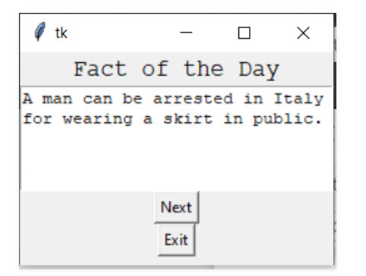
Python Tkinter – Text Widget

Slide 26
Summary
Introduction to Tkinter
Widgets in Tkinter
Label & Button widget
RadioButton & CheckBox widget
Combobox & Message widget
Entry & Text widget

